Slide 1


The Car Rental system

Slide 2


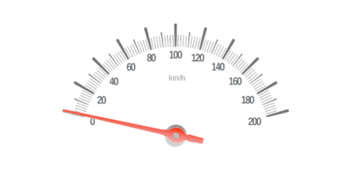
D21DCS153 Dhara Thakkar
8CSE1 | DEPSTAR
CS453 | SGP-VIII

Slide 3

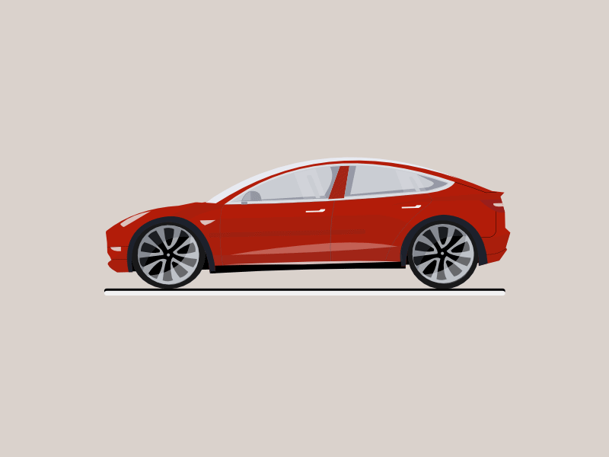
ABSTRACT
The CAR RENTAL SYSTEM is being developed for customers so that they can book their vehicles from anywhere. A customer being registered on the website has the facility to book a vehicle that he requires
The proposed system is completely integrated with online systems. It automates manual procedures in an effective and efficient way. It includes the type of vehicle they are trying to hire and the location. This system aims to develop a website for the people who can book their vehicles along with requirements from any part of the country.

Slide 4





PROJECT DESCRIPTION
DIAGRAMS
ADV. AND DISADV.
INTRODUCTION OF THE PROJECT

Slide 5





INTRODUCTION OF THE PROJECT

Slide 6

INTRODUCTION
A vehicle rental that can be used temporarily for a fee for specified period. Getting rental vehicles helps people get around despite the fact they do not have access to their own personal vehicle.
Going digitally by making vehicle renting business automatic and online is the key efficient management of this website for various daily travelling purposes of our users.

Slide 7
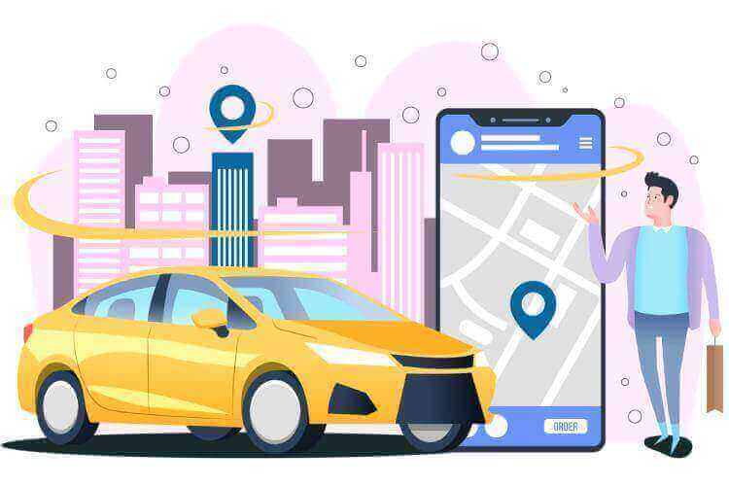
DEFINITION
We developed this project to book vehicles on rent at the fare charges. In present system all booking work is done manually and it takes very hard work to maintain the information of booking and vehicles.
This aim of the project is to automate the work performed in the vehicle rental management system like generating daily bookings, records of various vehicles available for booking, record of routes available, rental charges for them for every route, store record of the customer.
It is a system design specially for large, premium and small vehicle rental business. The vehicle rental system provides complete functionality of listing and booking various vehicles. In this system, Tourism and Travelling facilities are also provided.

Slide 8

OBJECT & SCOPE
Record data of customers and keep it secured.
Give updates anytime.
Highly integrated system.
Cost effective online system.
Supports multiple languages for people.
User friendly and easy to understand.

Slide 9



PROJECT DESCRIPTION

Slide 10

STUDY OF TECHNOLOGY

Slide 11

SYSTEM ANALYSIS
Hardware Specification:
4 GB RAM
i3 processor
256 HDD
Software Specifications:
VS Code
NodeJS
Mongo dB
ReactJS
Windows 11 OS
ExpressJS

Slide 12



DIAGRAMS

Slide 13
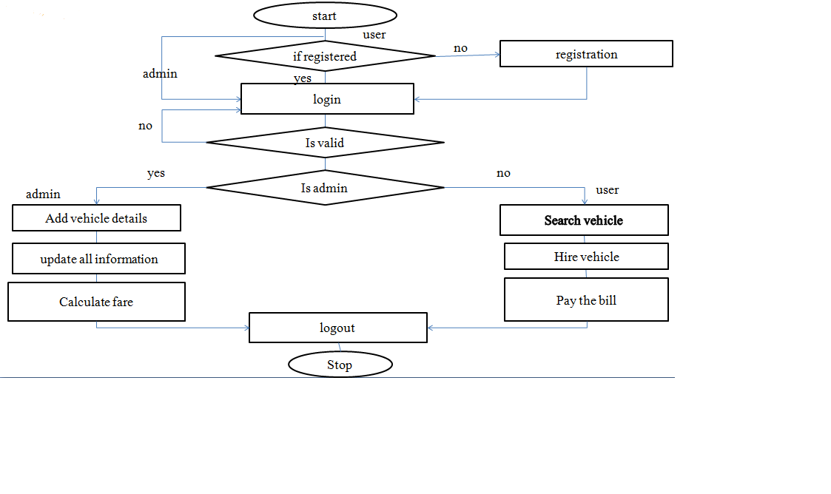
SYSTEM FLOWCHART

Slide 14
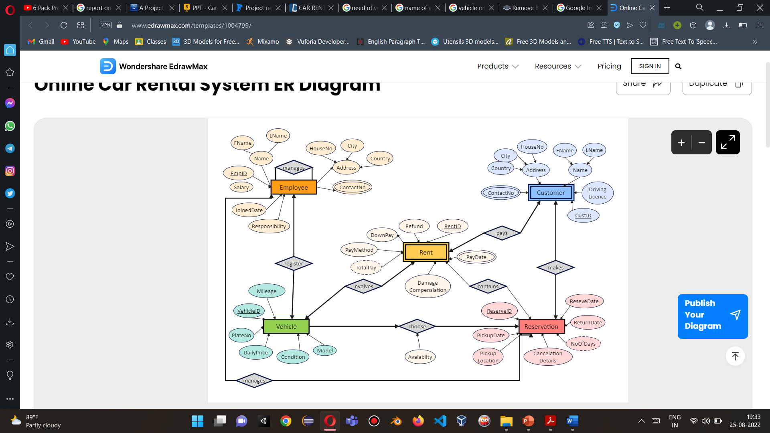
ER DIAGRAM

Slide 15



ADV. AND DISADV.

Slide 16
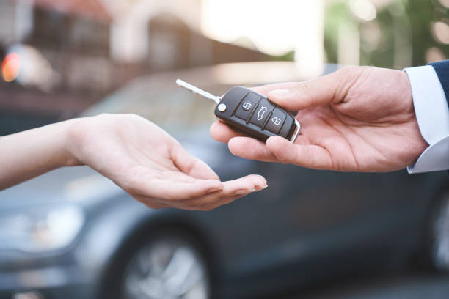
ADVANTAGES
Convenience in travelling.
Flexibility on route taking.
A wide selection of vehicles.
Quality Service
Owning a Car is Not Necessary
Renting Huge Vehicles
Excellent for Vacation
Getting Better Mileage

Slide 17
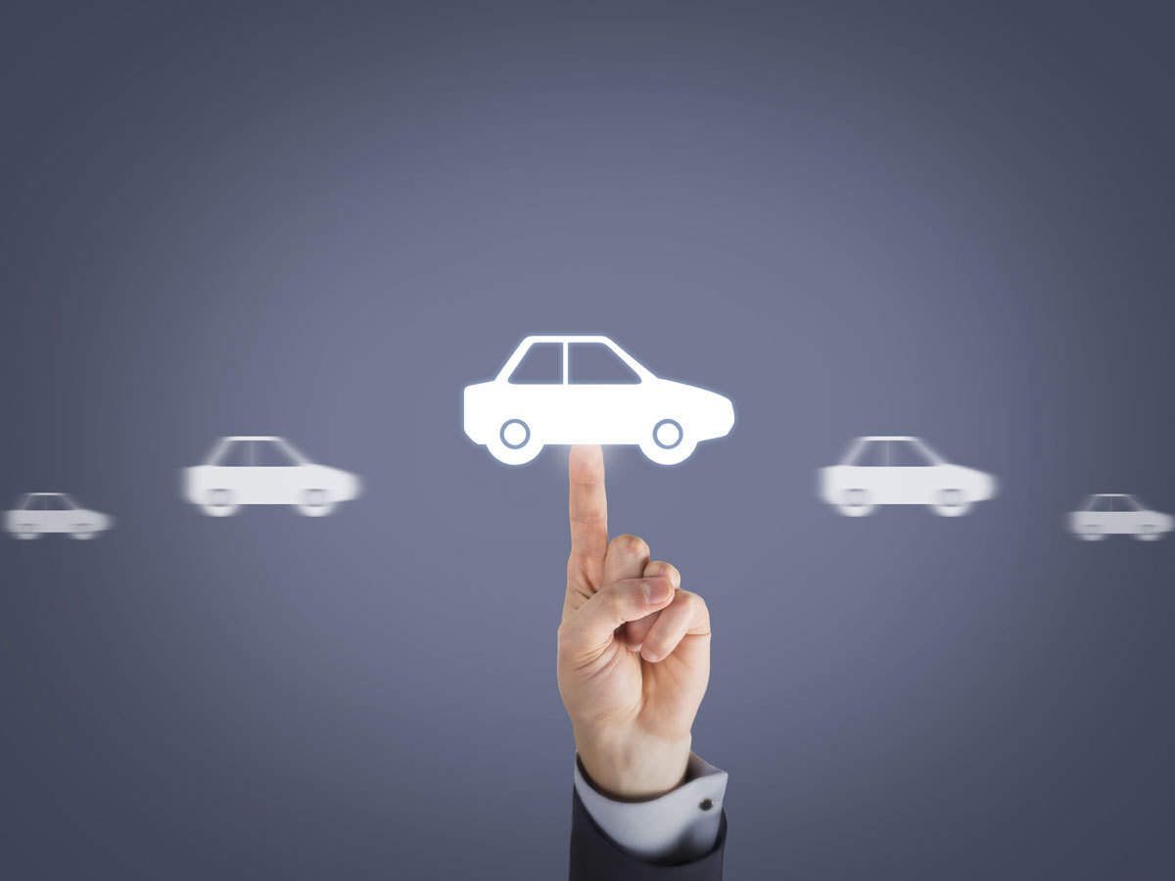
DISADVANTAGES
Strict Terms and Conditions.
Availability of proper network connection in remote areas in your smart device.
Pick and drop location may vary.
Limited vehicles available.

Slide 18
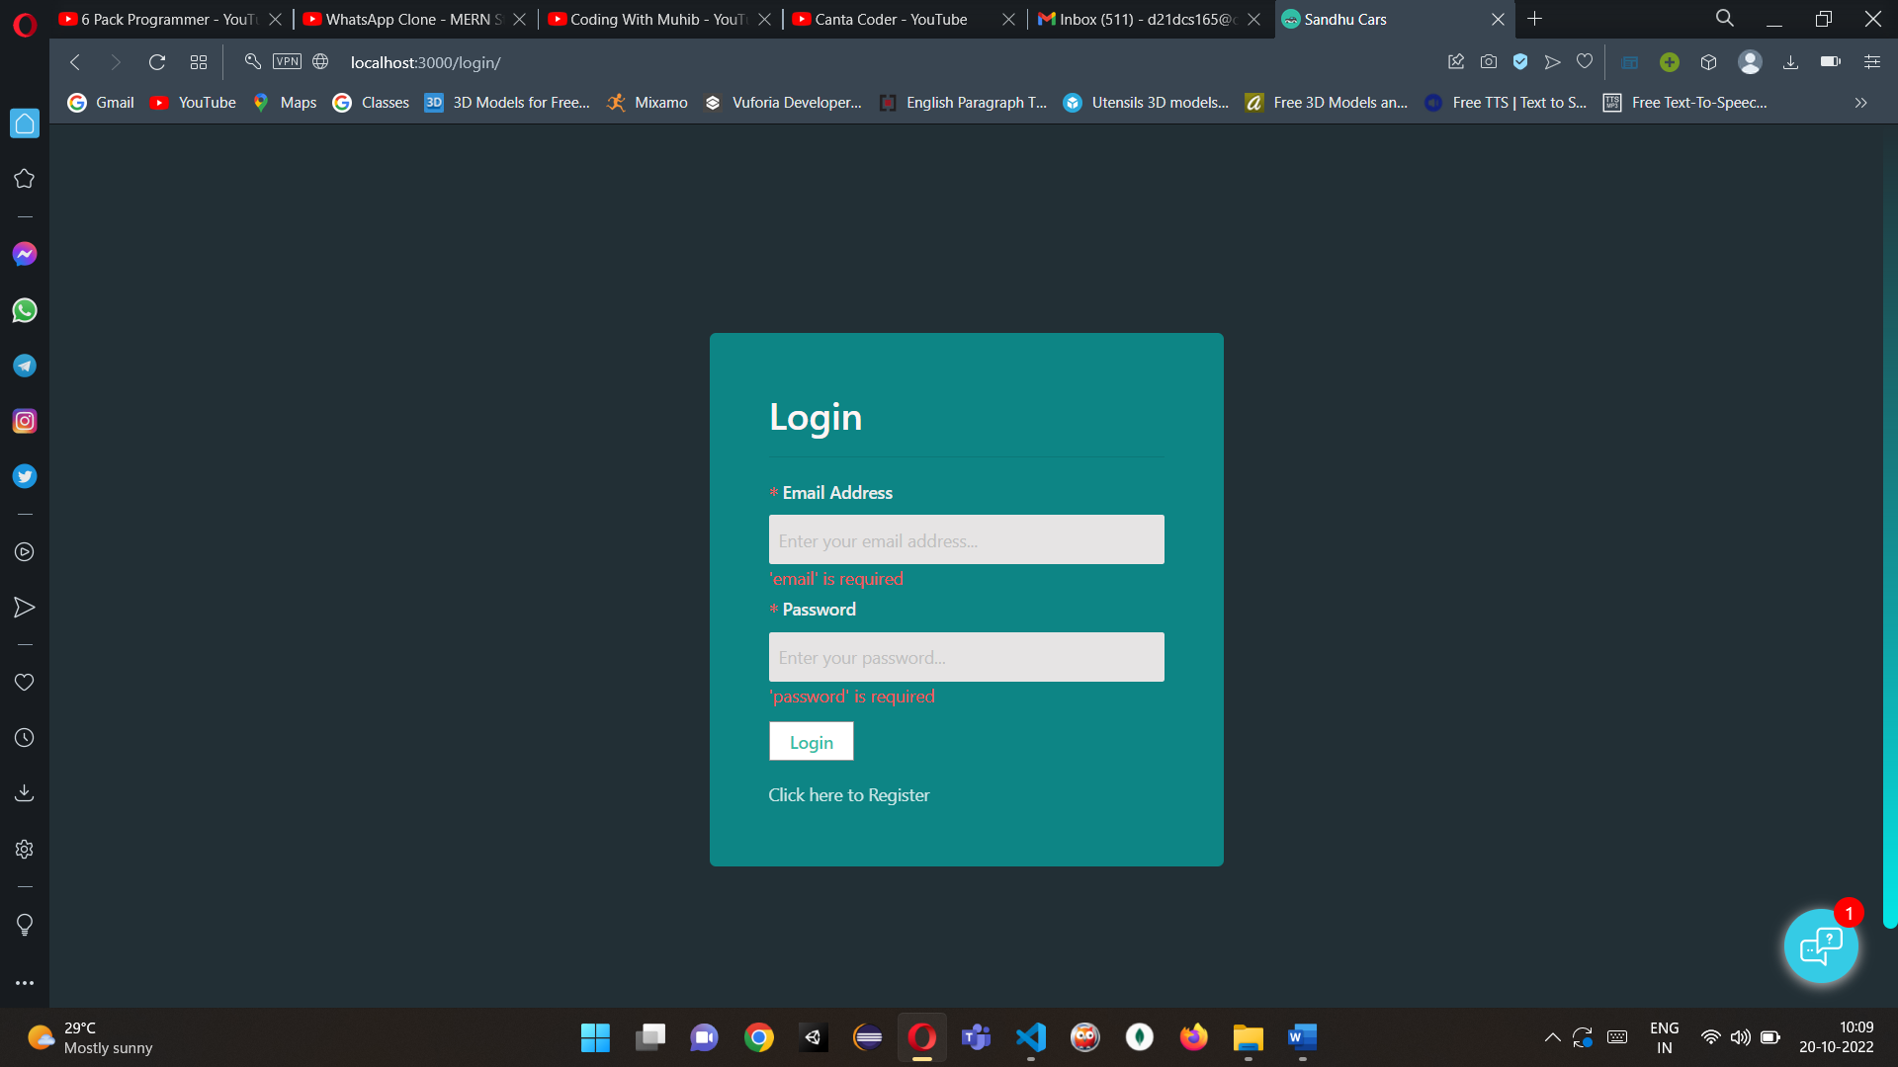
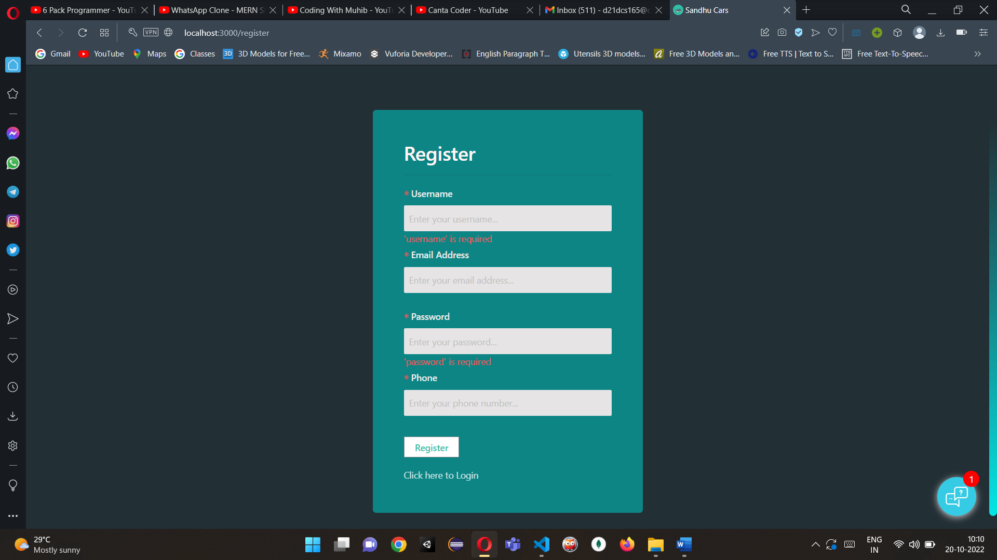
Screenshots of project
Login Page
Register Page

Slide 19
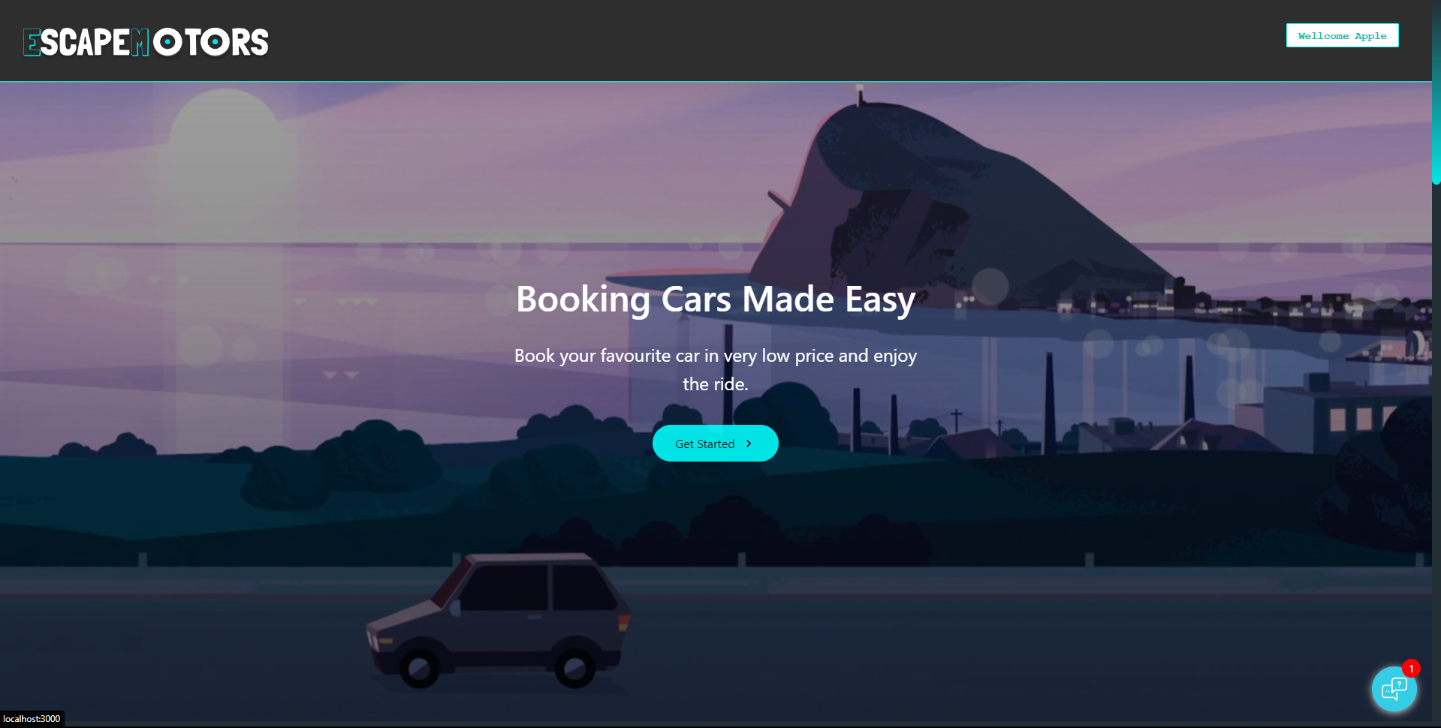
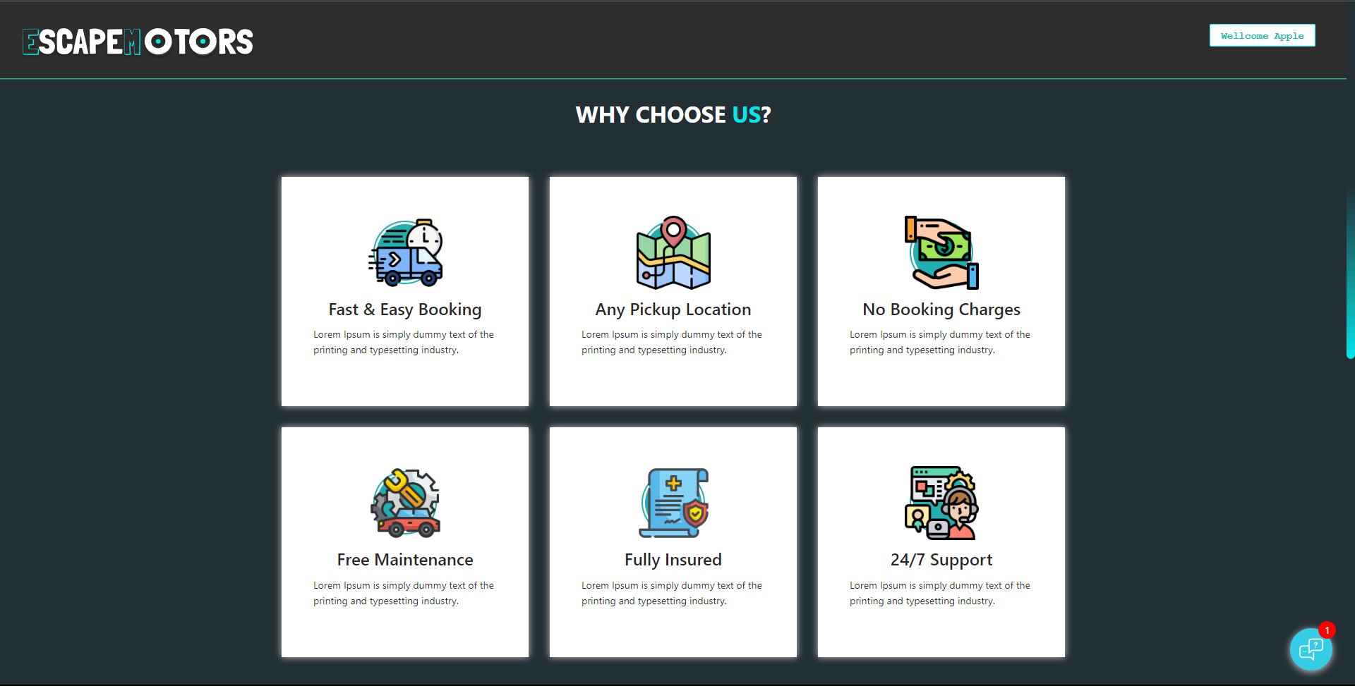
Screenshots of project
Home Page
About Us and Feature Page

Slide 20
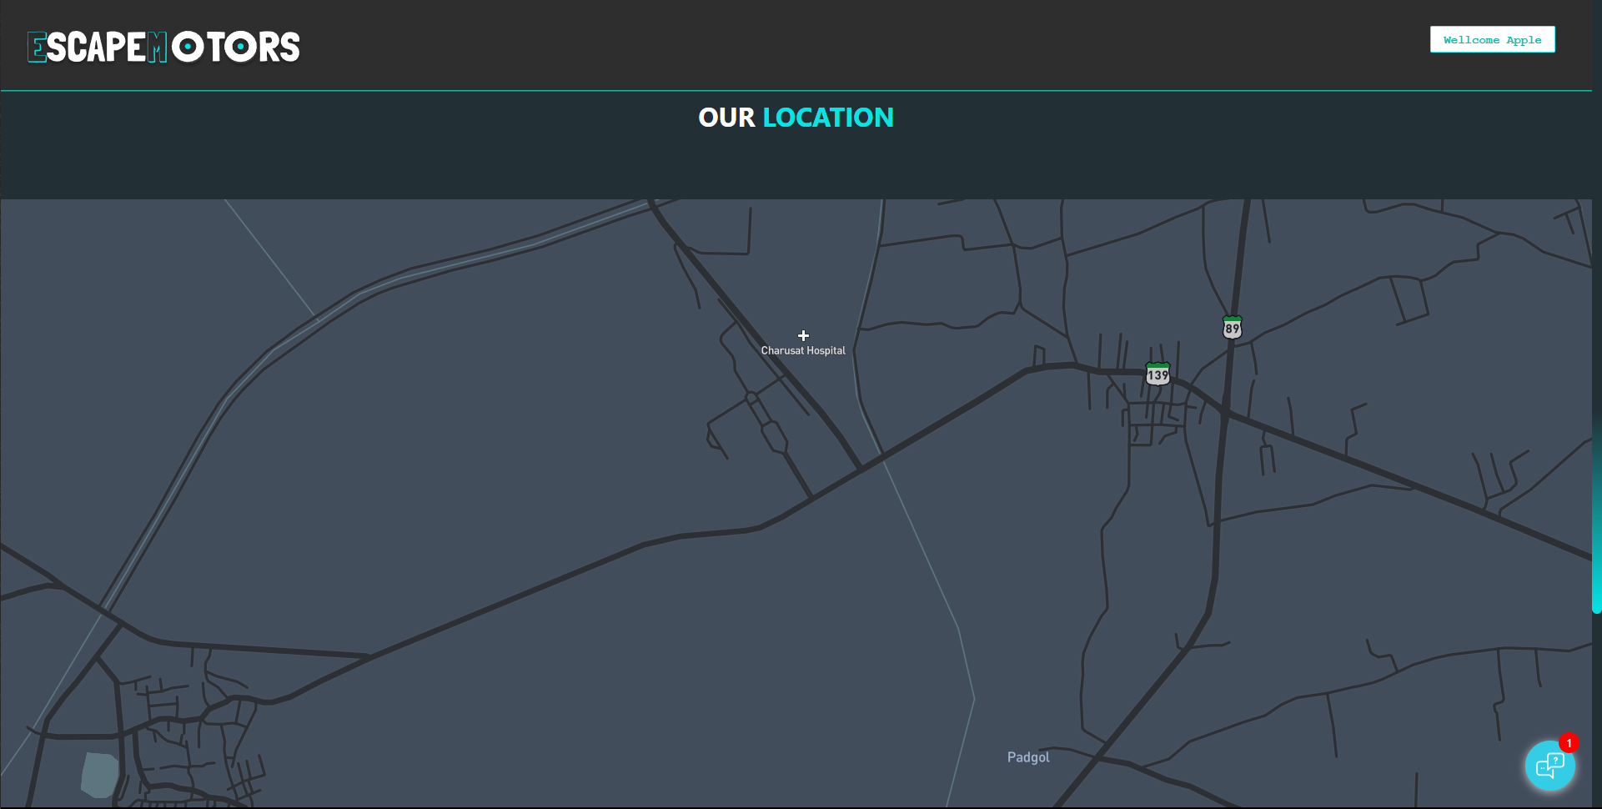
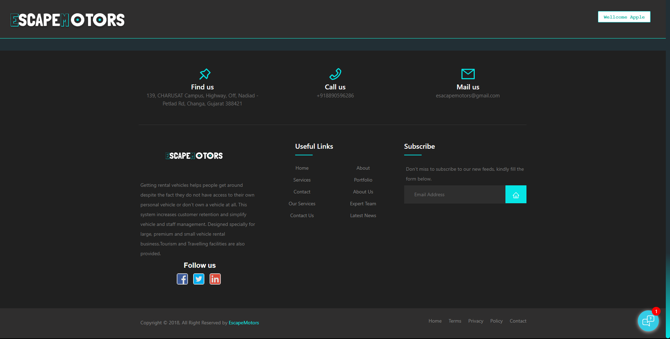
Screenshots of project
Location of Head Office
Footer

Slide 21
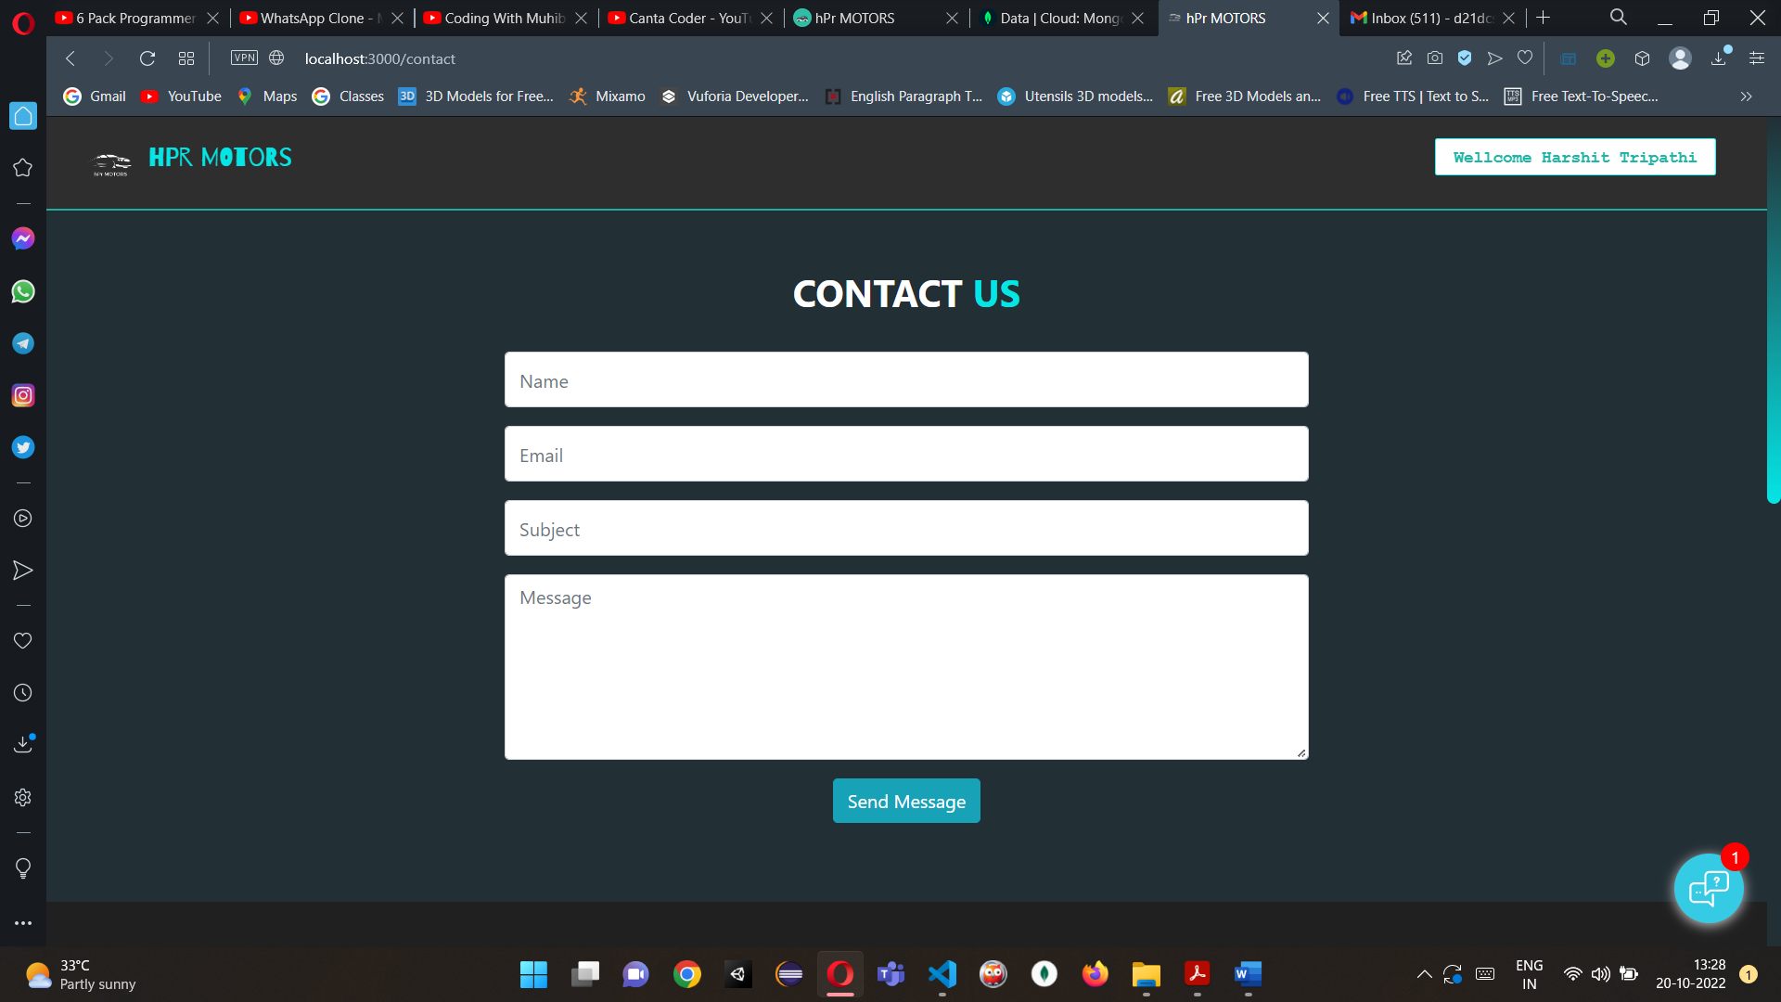
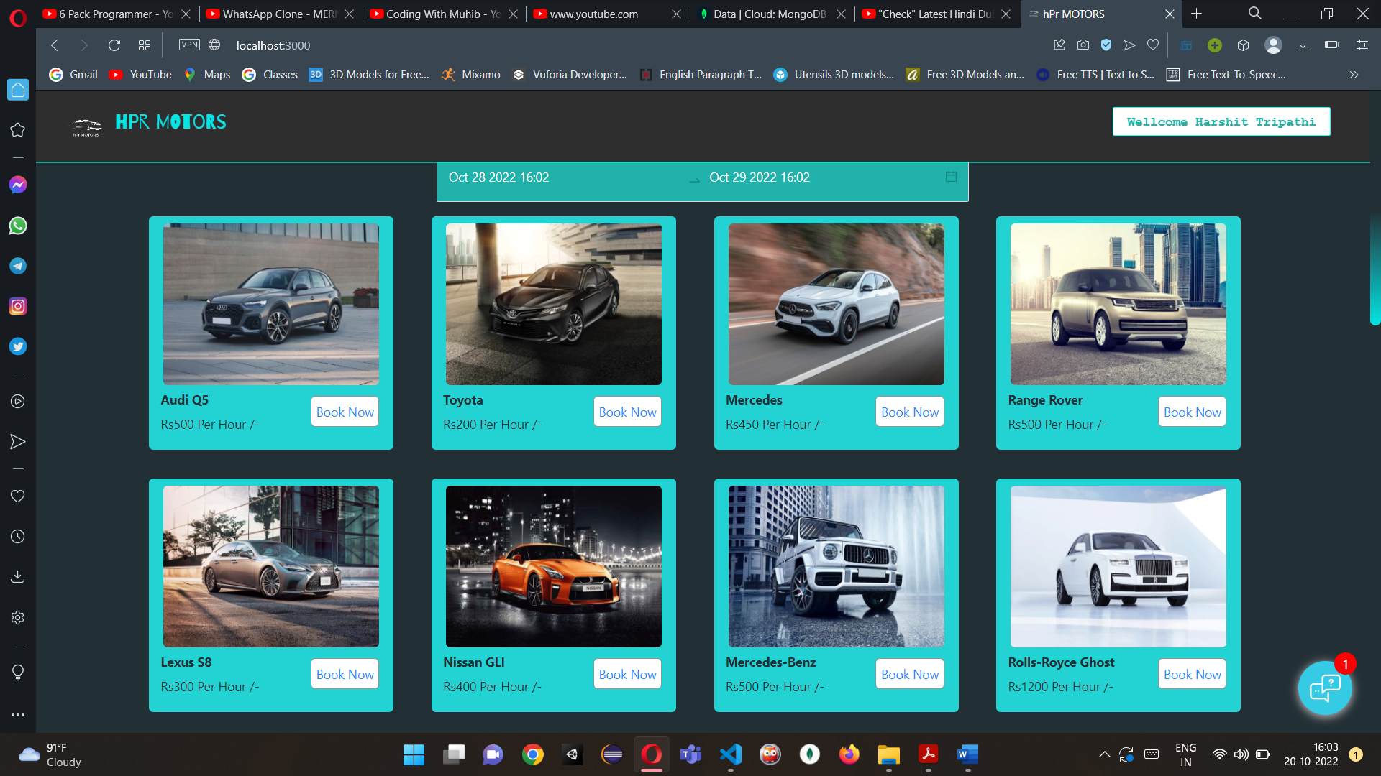
Screenshots of project
Contact Page
Car Booking Page

Slide 22
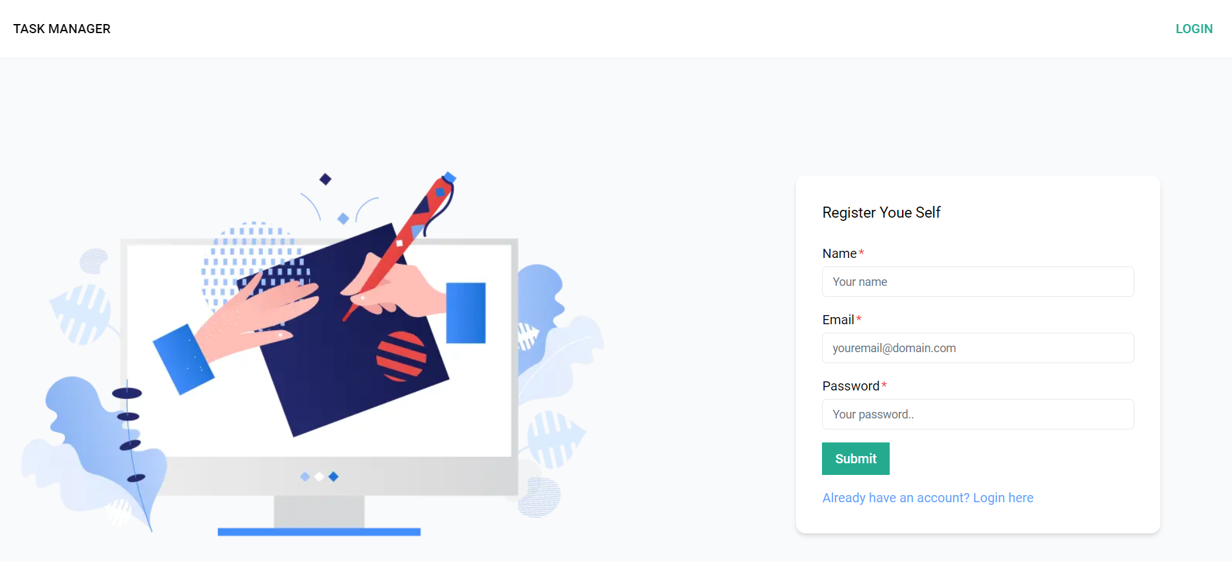
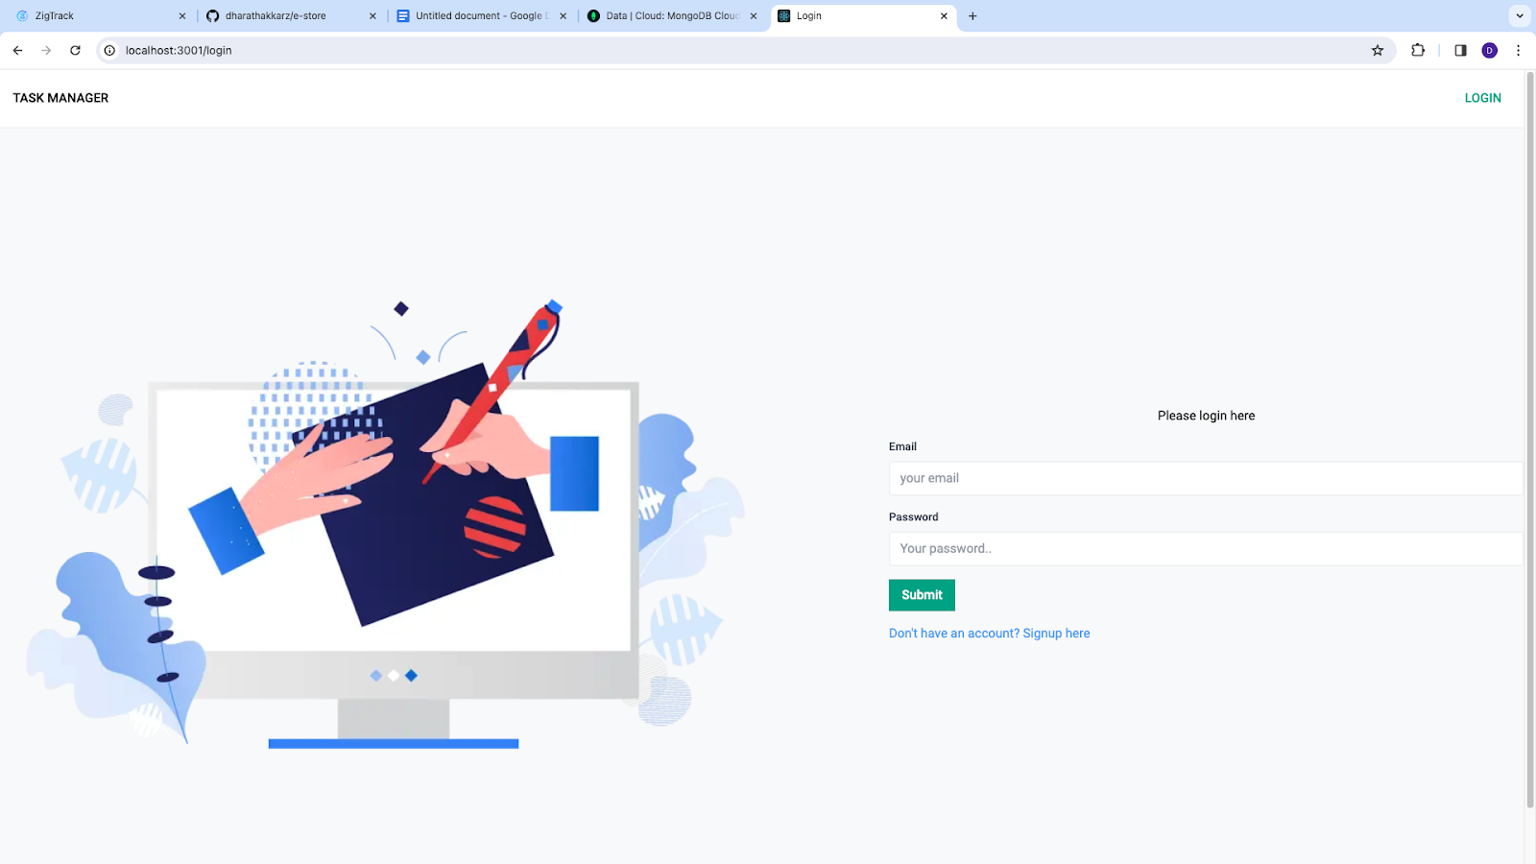
Screenshots of other task
Along with the car rental system I also work on other task
1.Task-Management -App
Registration page
Login page

Slide 23
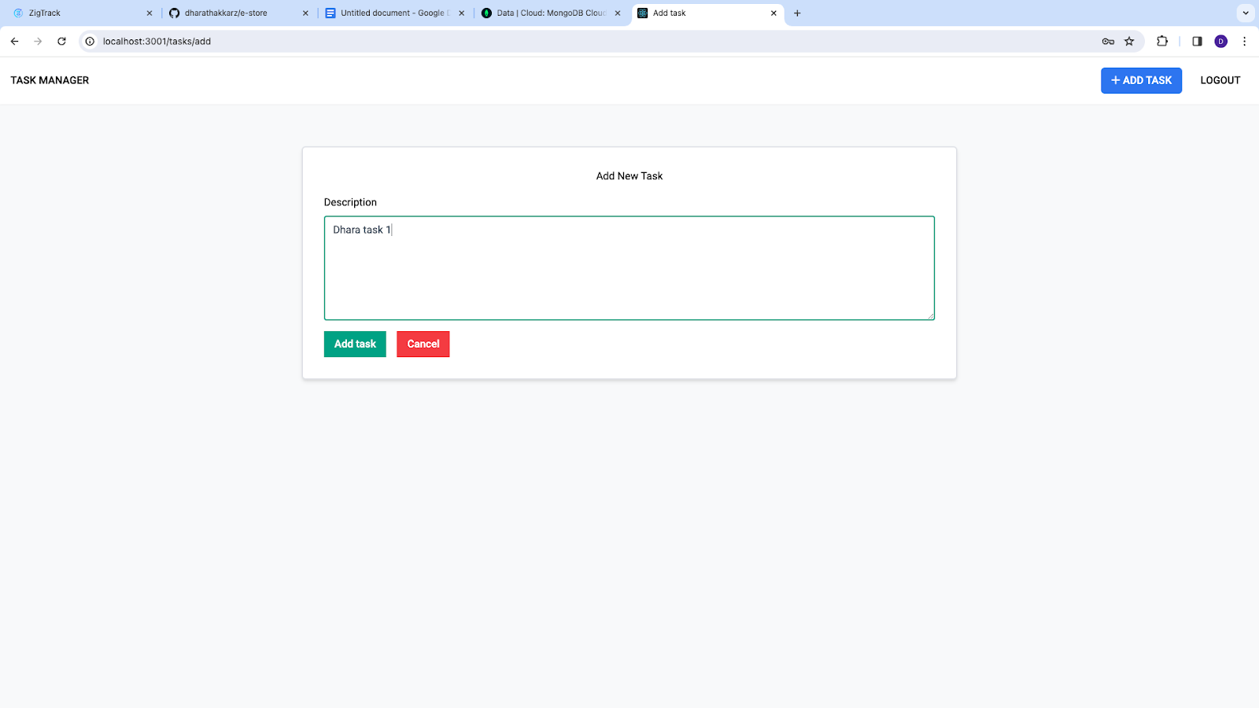
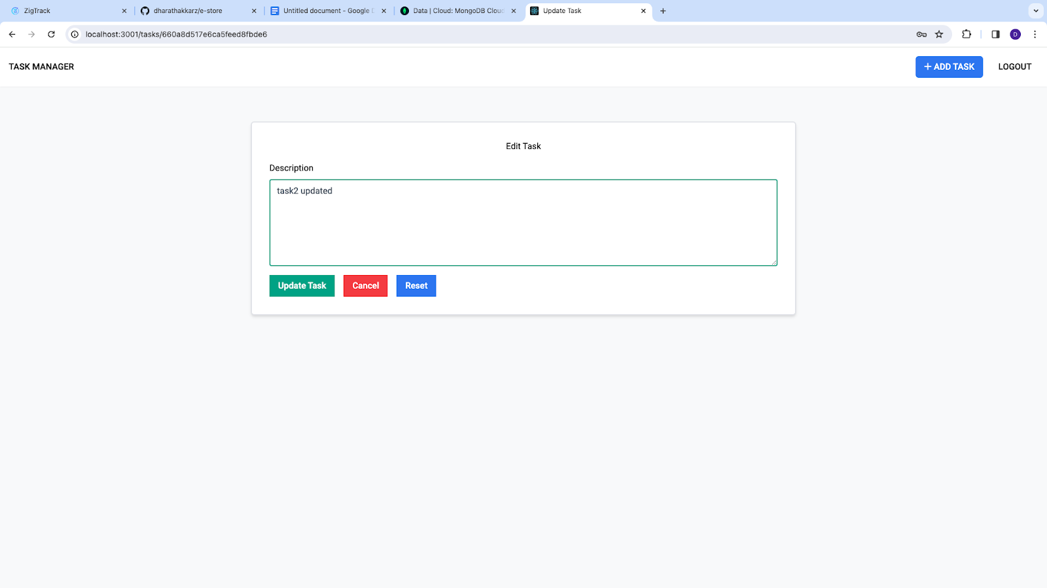
Screenshots of other task
Along with the car rental system I also work on other task
1.Task-Management -App
Add Task page
Update Task page

Slide 24
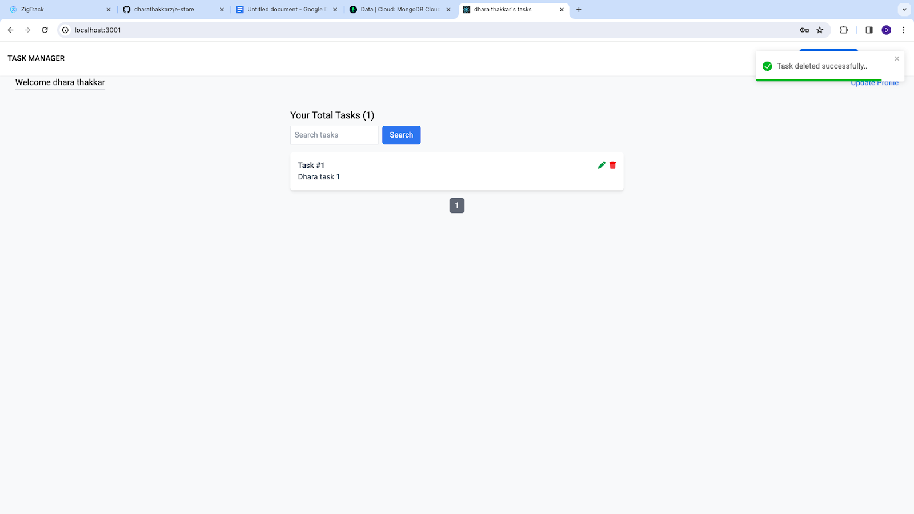
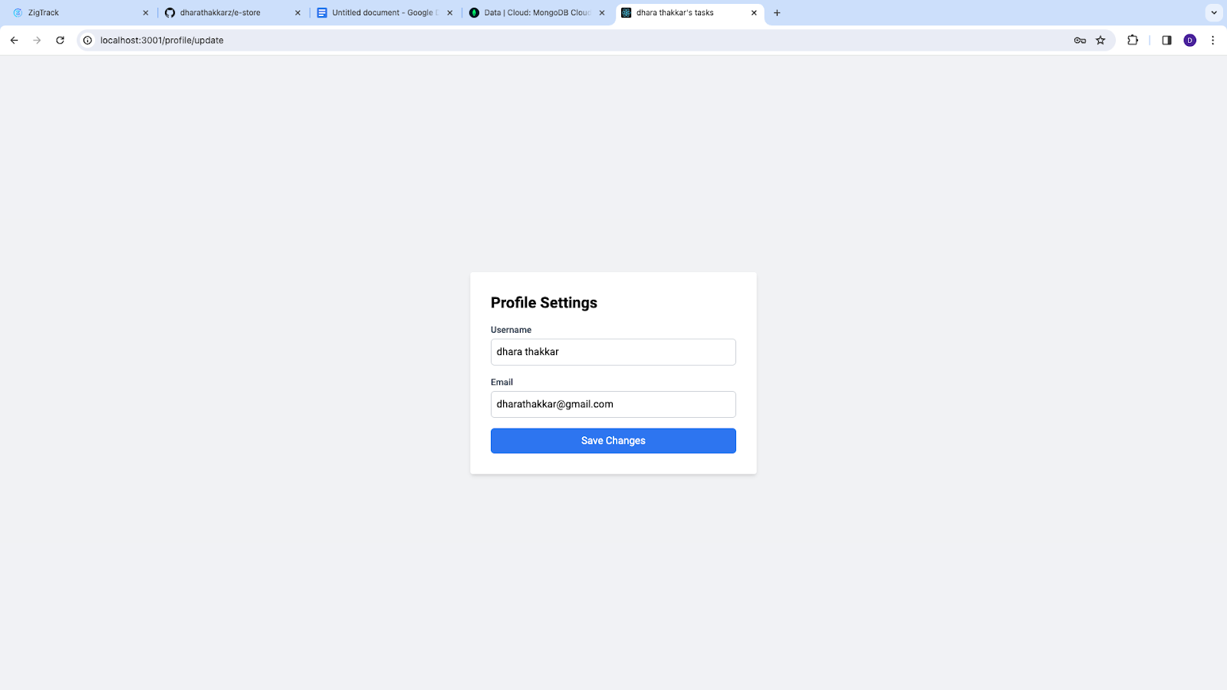
Screenshots of other task
Along with the car rental system I also work on other task
1.Task-Management -App
Task search and pagination page
Profile Update page

Slide 25
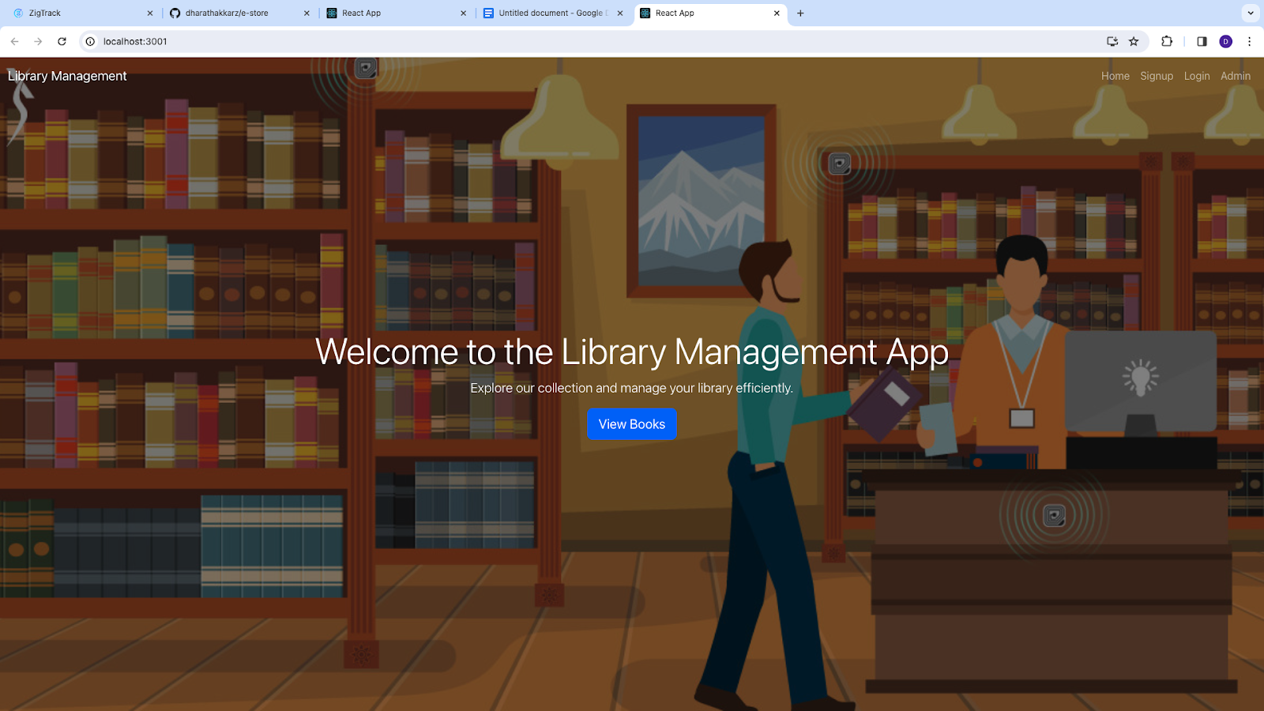
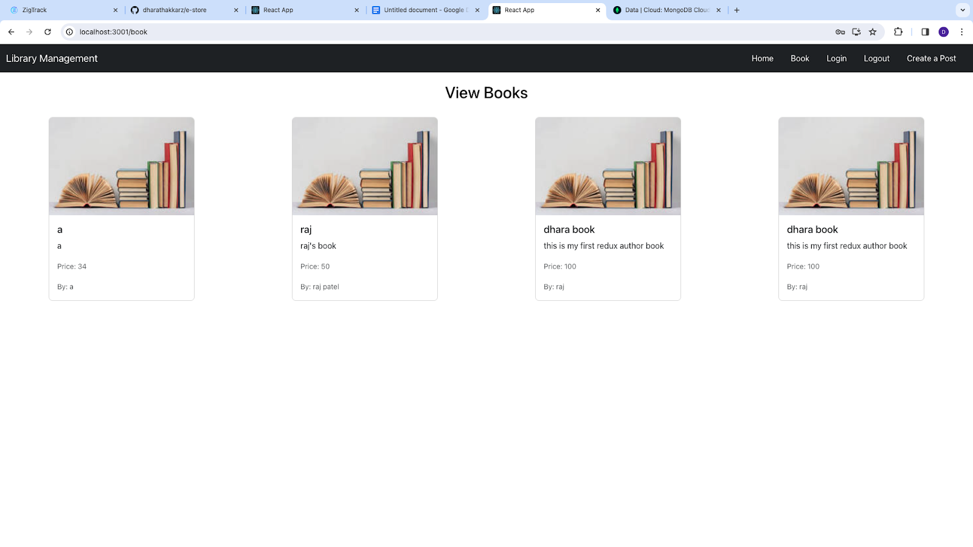
Screenshots of other task
Along with the car rental system I also work on other task
2.Library Management System
Home page
All Books page

Slide 26
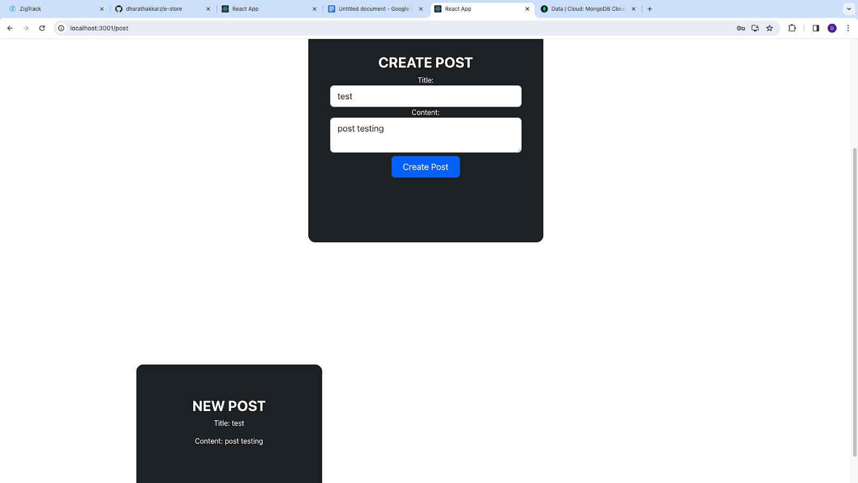
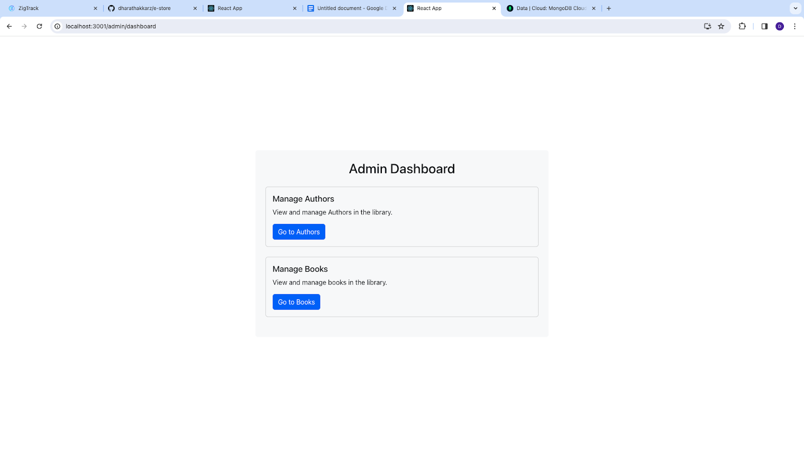
Screenshots of other task
Along with the car rental system I also work on other task
2.Library Management System
PersonalPost page
Admin page

Slide 27
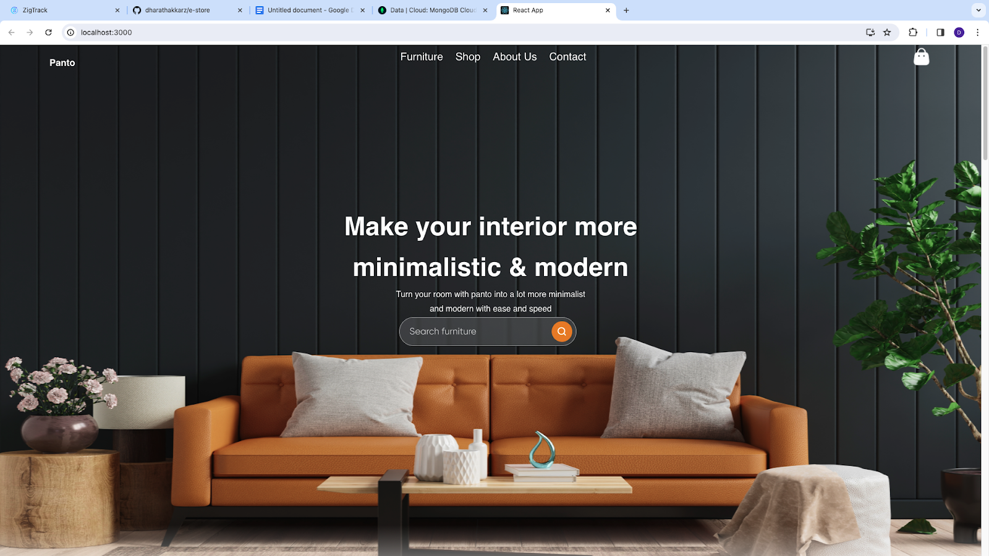
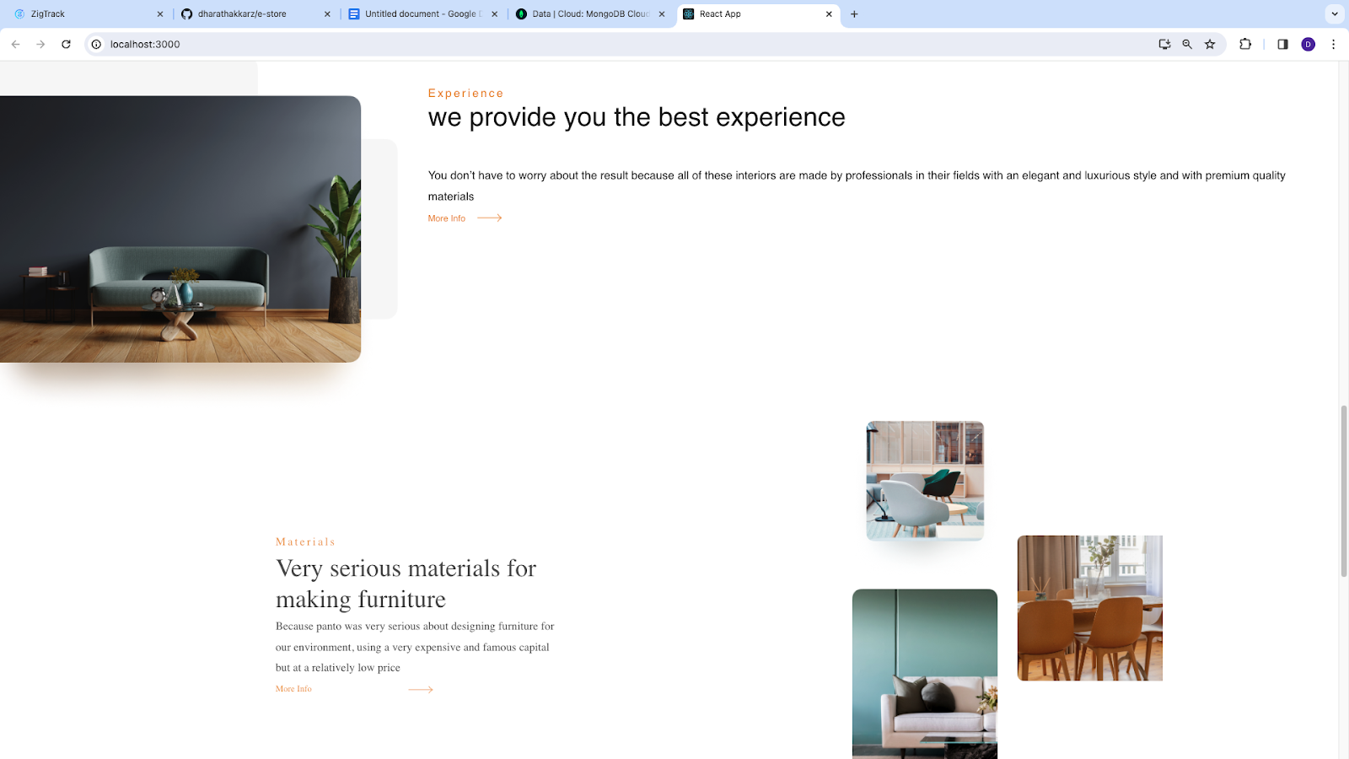
Screenshots of other task
Along with the car rental system I also work on other task
3.Figma UI Design

Slide 28
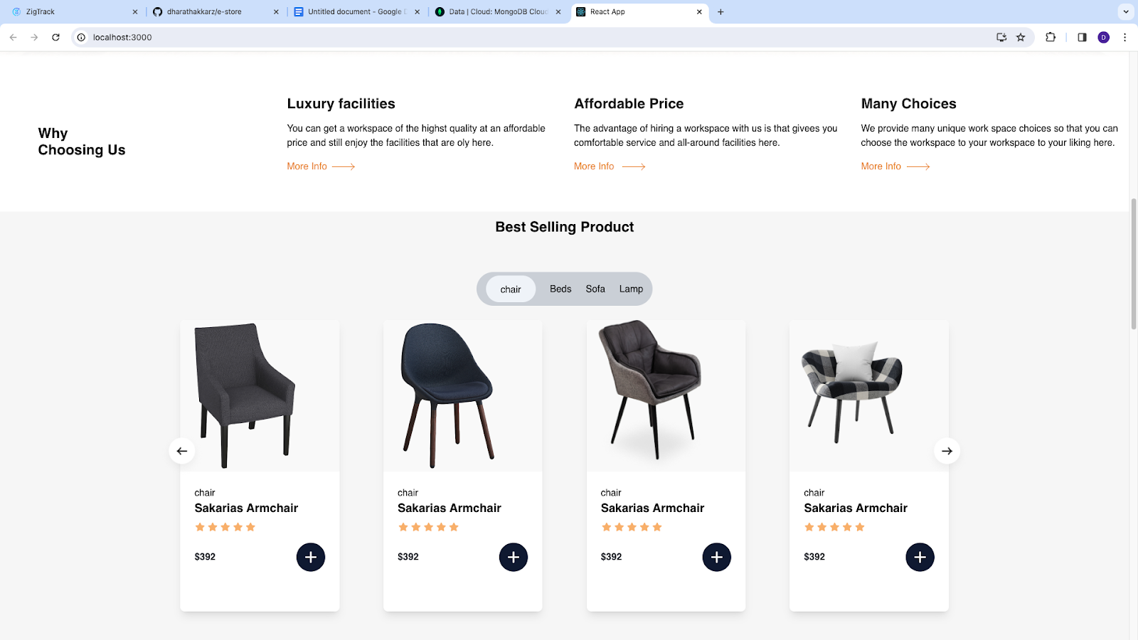
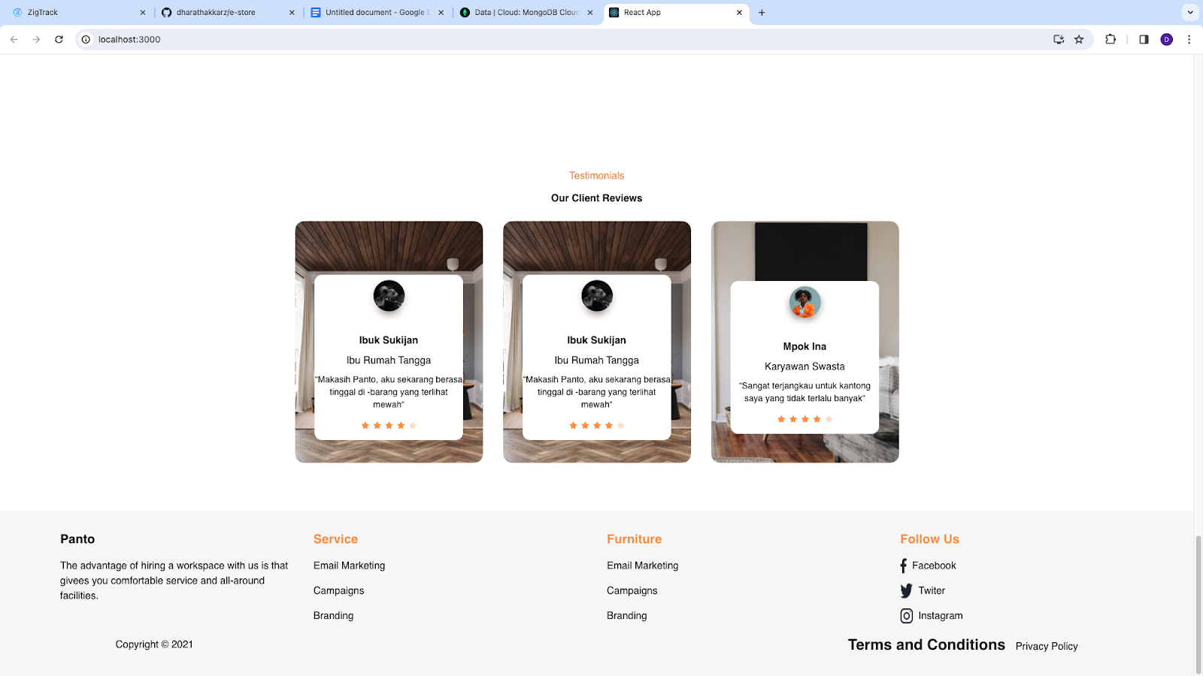
Screenshots of other task
Along with the car rental system I also work on other task
3.Figma UI Design

Slide 29
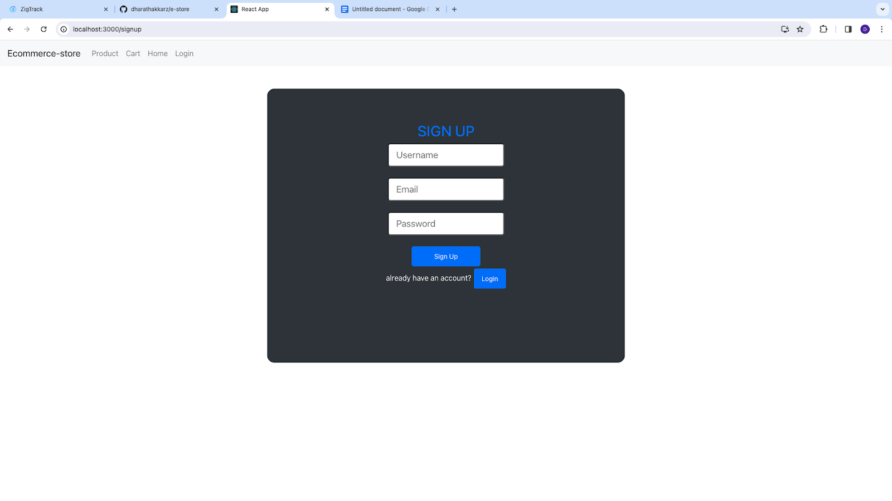
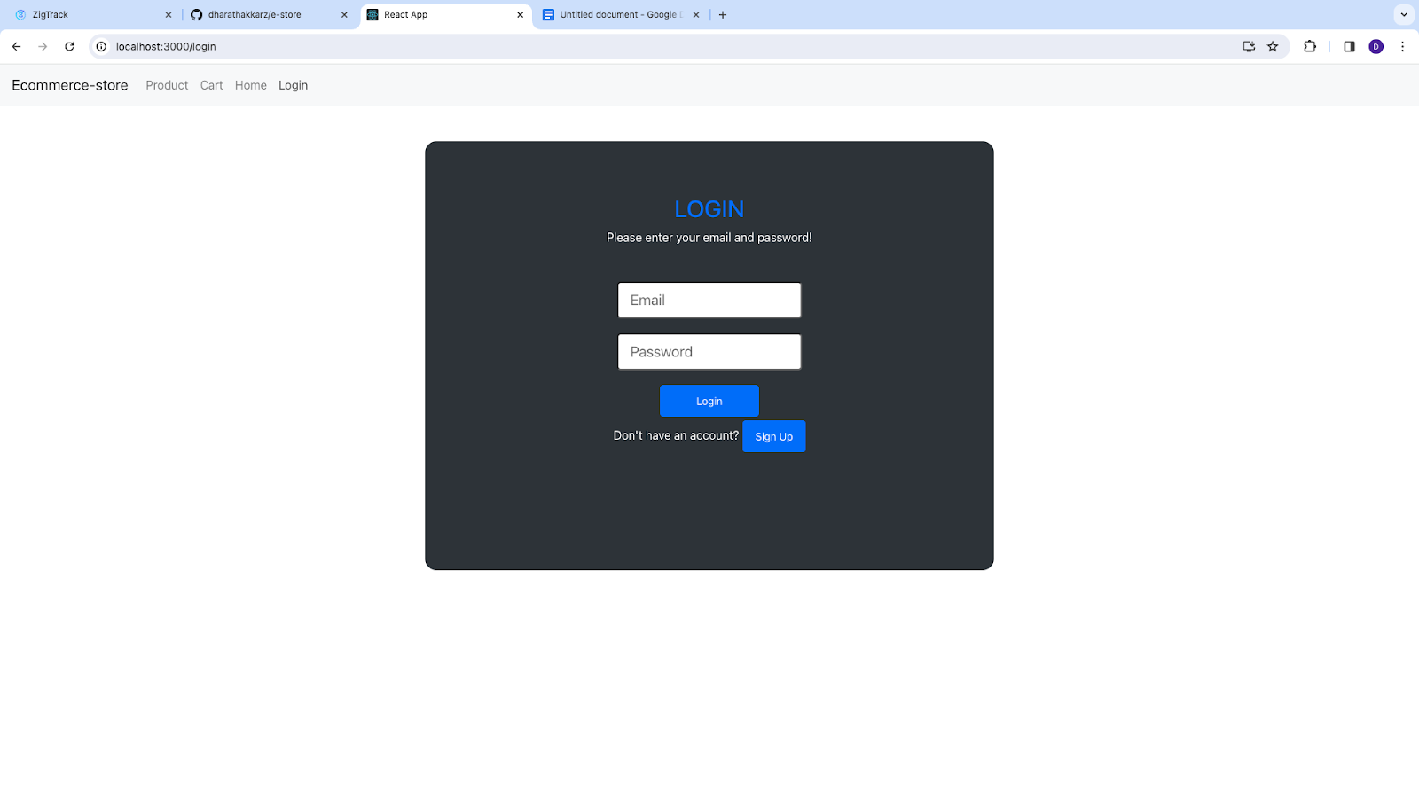
Screenshots of other task
Along with the car rental system I also work on other task
4.E-commerce Fronted side

Slide 30
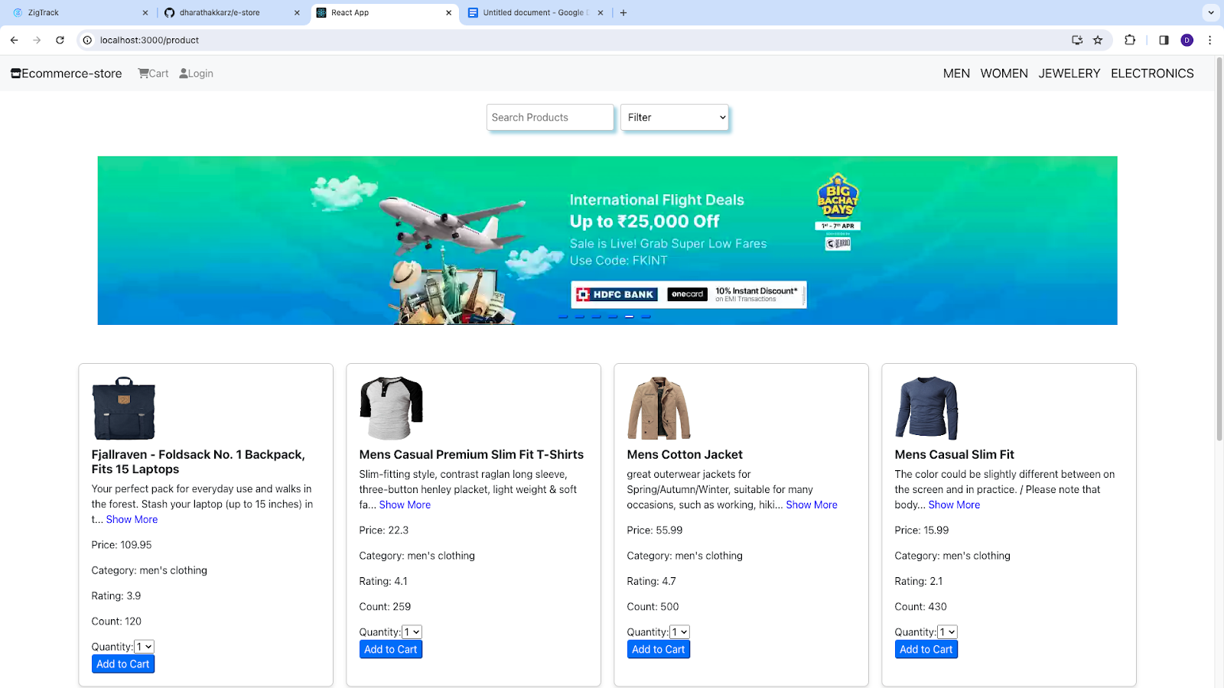
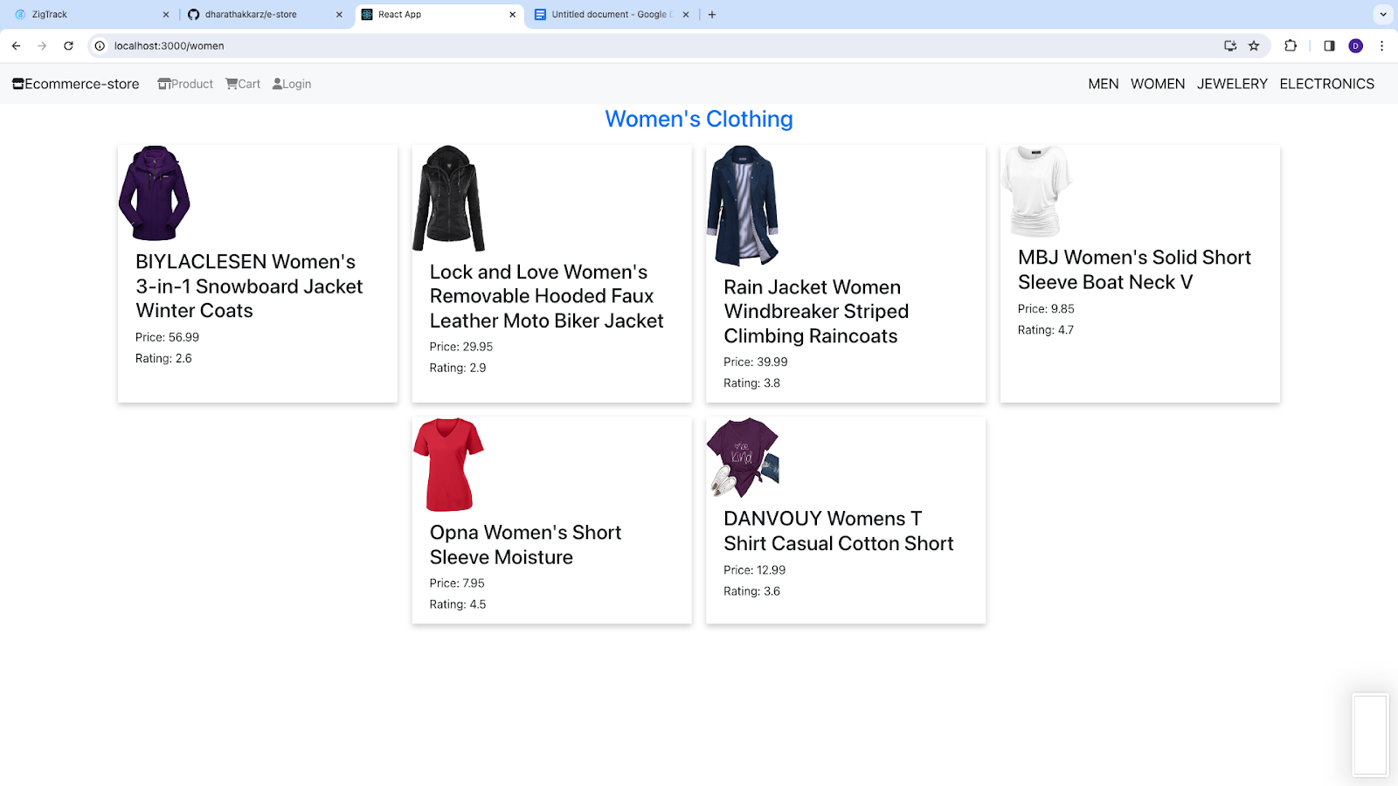
Screenshots of other task
Along with the car rental system I also work on other task
4.E-commerce Fronted side

Slide 31
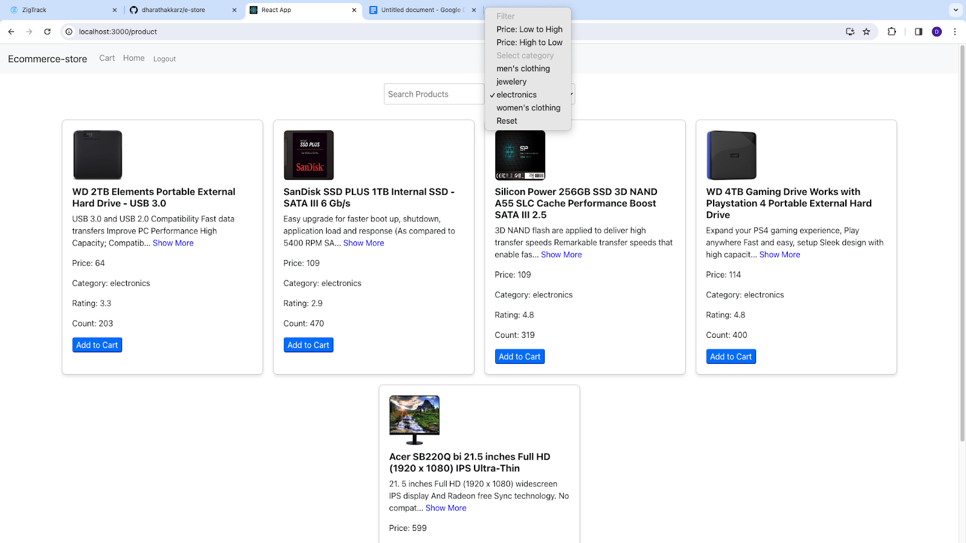
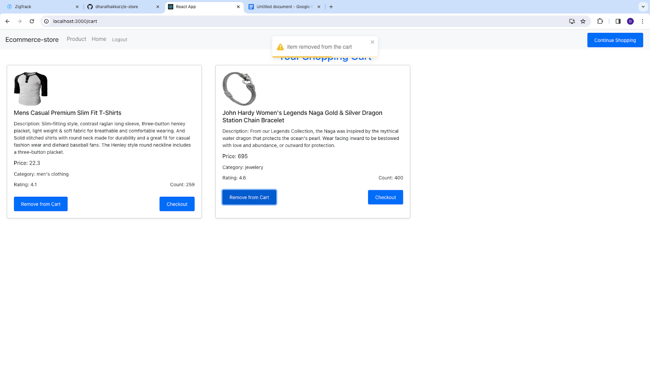
Screenshots of other task
Along with the car rental system I also work on other task
4.E-commerce Fronted side

Slide 32


